Slide 1
PERSONAL PROTECTIVE EQUIPMENT IN BSL-3 & ABSL-3
PERSONAL PROTECTIVE
EQUIPMENT IN
BSL-3 & ABSL-3
Laboratories
Nicole Marlenee, DVM, ARO
Biosafety Officer, Colorado State University

Slide 2
What determines biosafety levels?
Containment
Primary and secondary barriers
Facility practices and procedures
Other safety equipment – PPE
Four Biosafety Levels
Primary Risks
Infectivity
Severity of disease
Transmissibility
Nature of the work conducted
Route of exposure

Slide 3
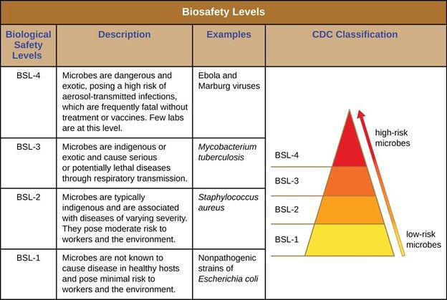

Slide 4
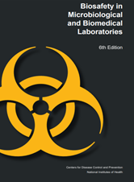
RISK ASSESSMENT

Slide 5
What PPE do you need?
Last line of defense!
BSL-3 PPE Factors
Medical clearance
Vaccinations & Surveillance Programs
Personal Health Status

Slide 6
Common PPE for BSL-3 Work
Scrubs
Facility socks
Respiratory protection
Hair net or pulled back
Double gloves
Facility shoes

Slide 7
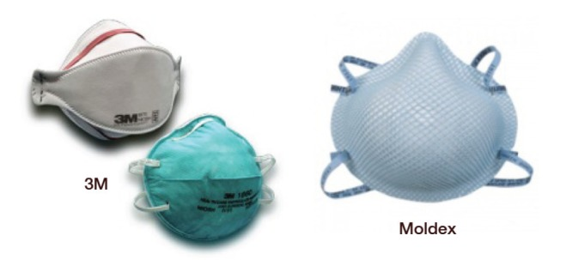
Respirators: N-95 and PAPR

Slide 8
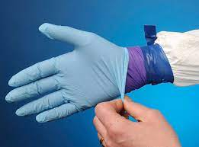
Gloves

Slide 9
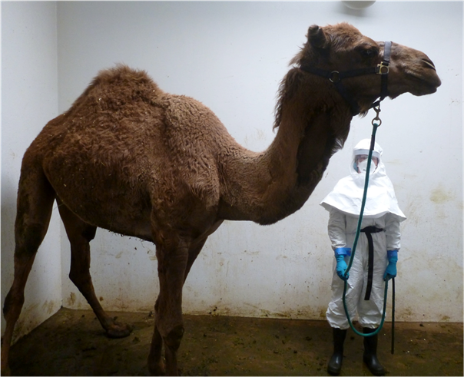
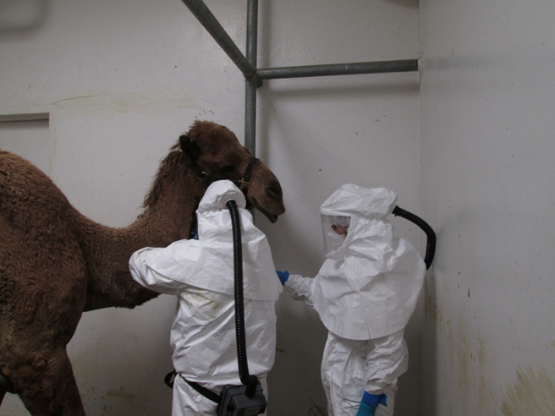
ABSL-3 PPE

Slide 10
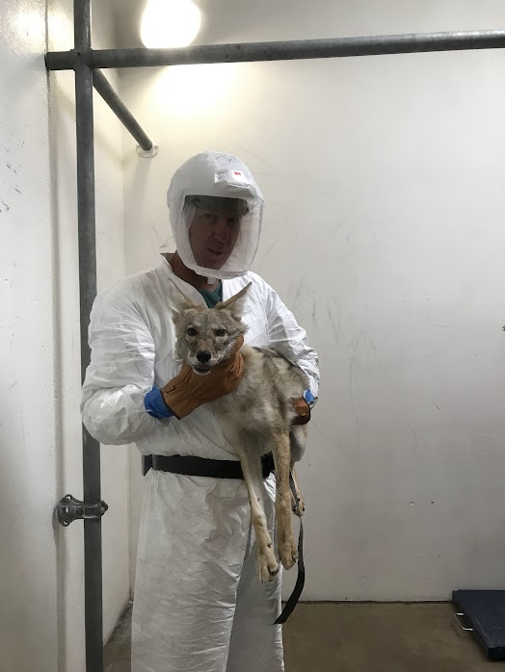
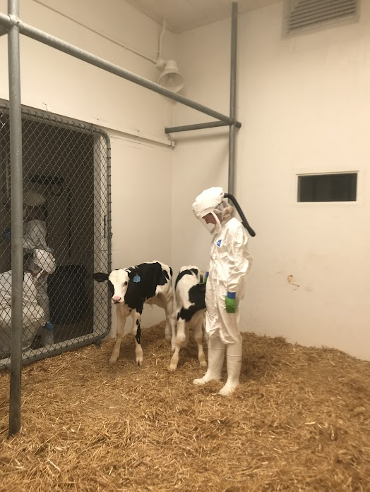
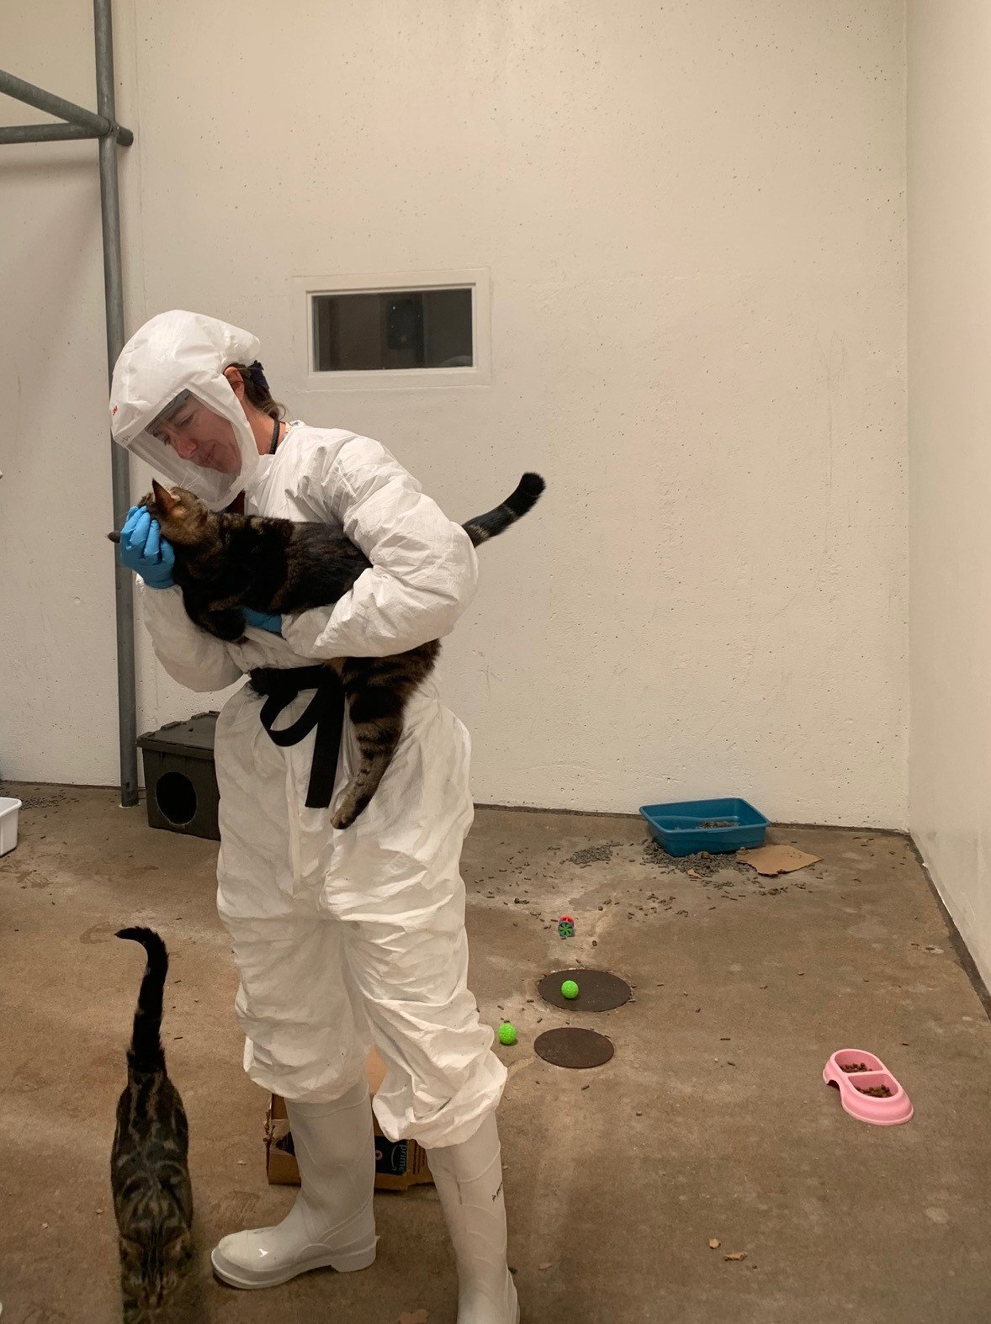
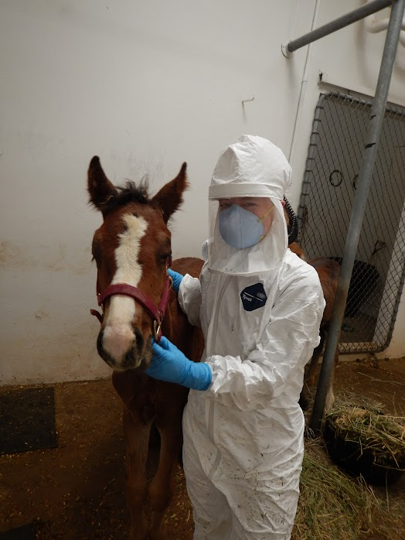

Slide 11
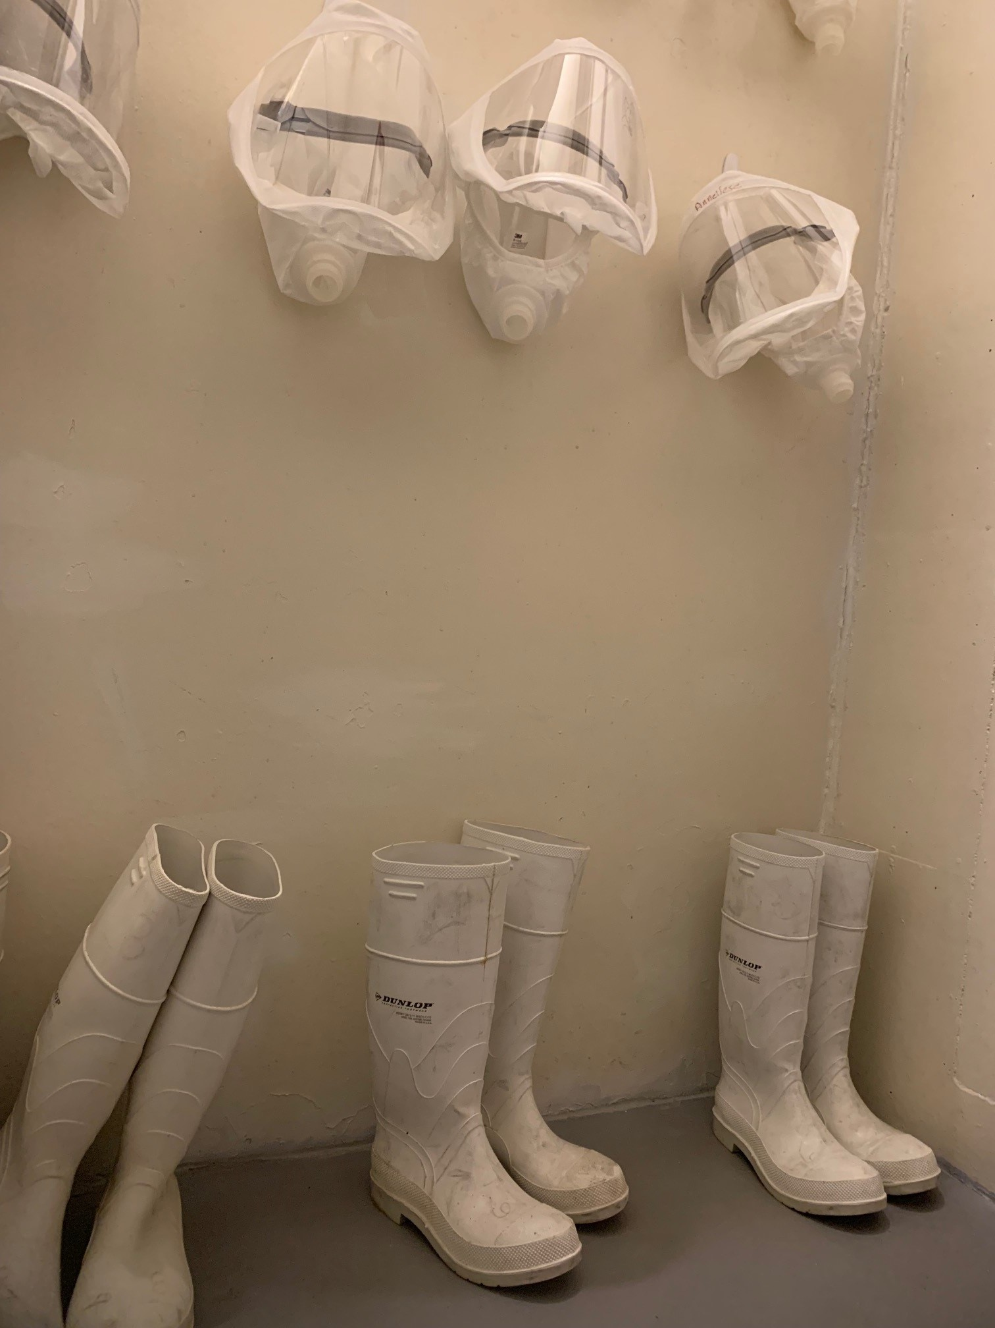
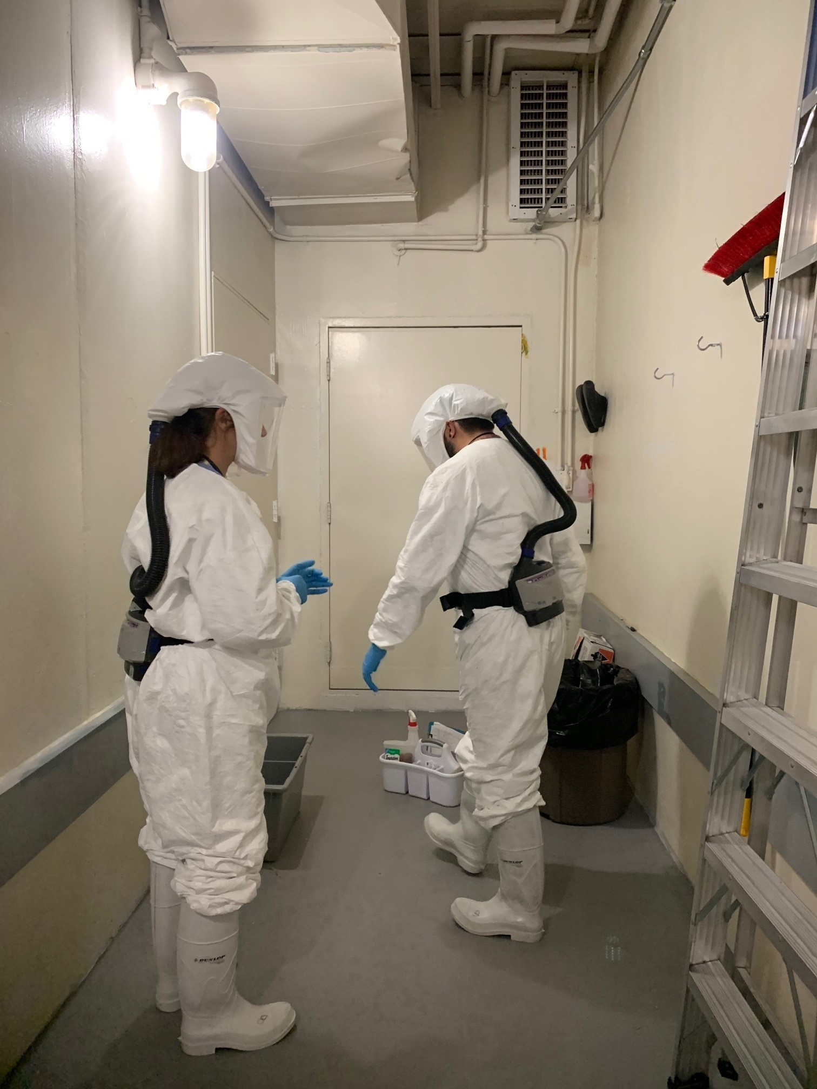
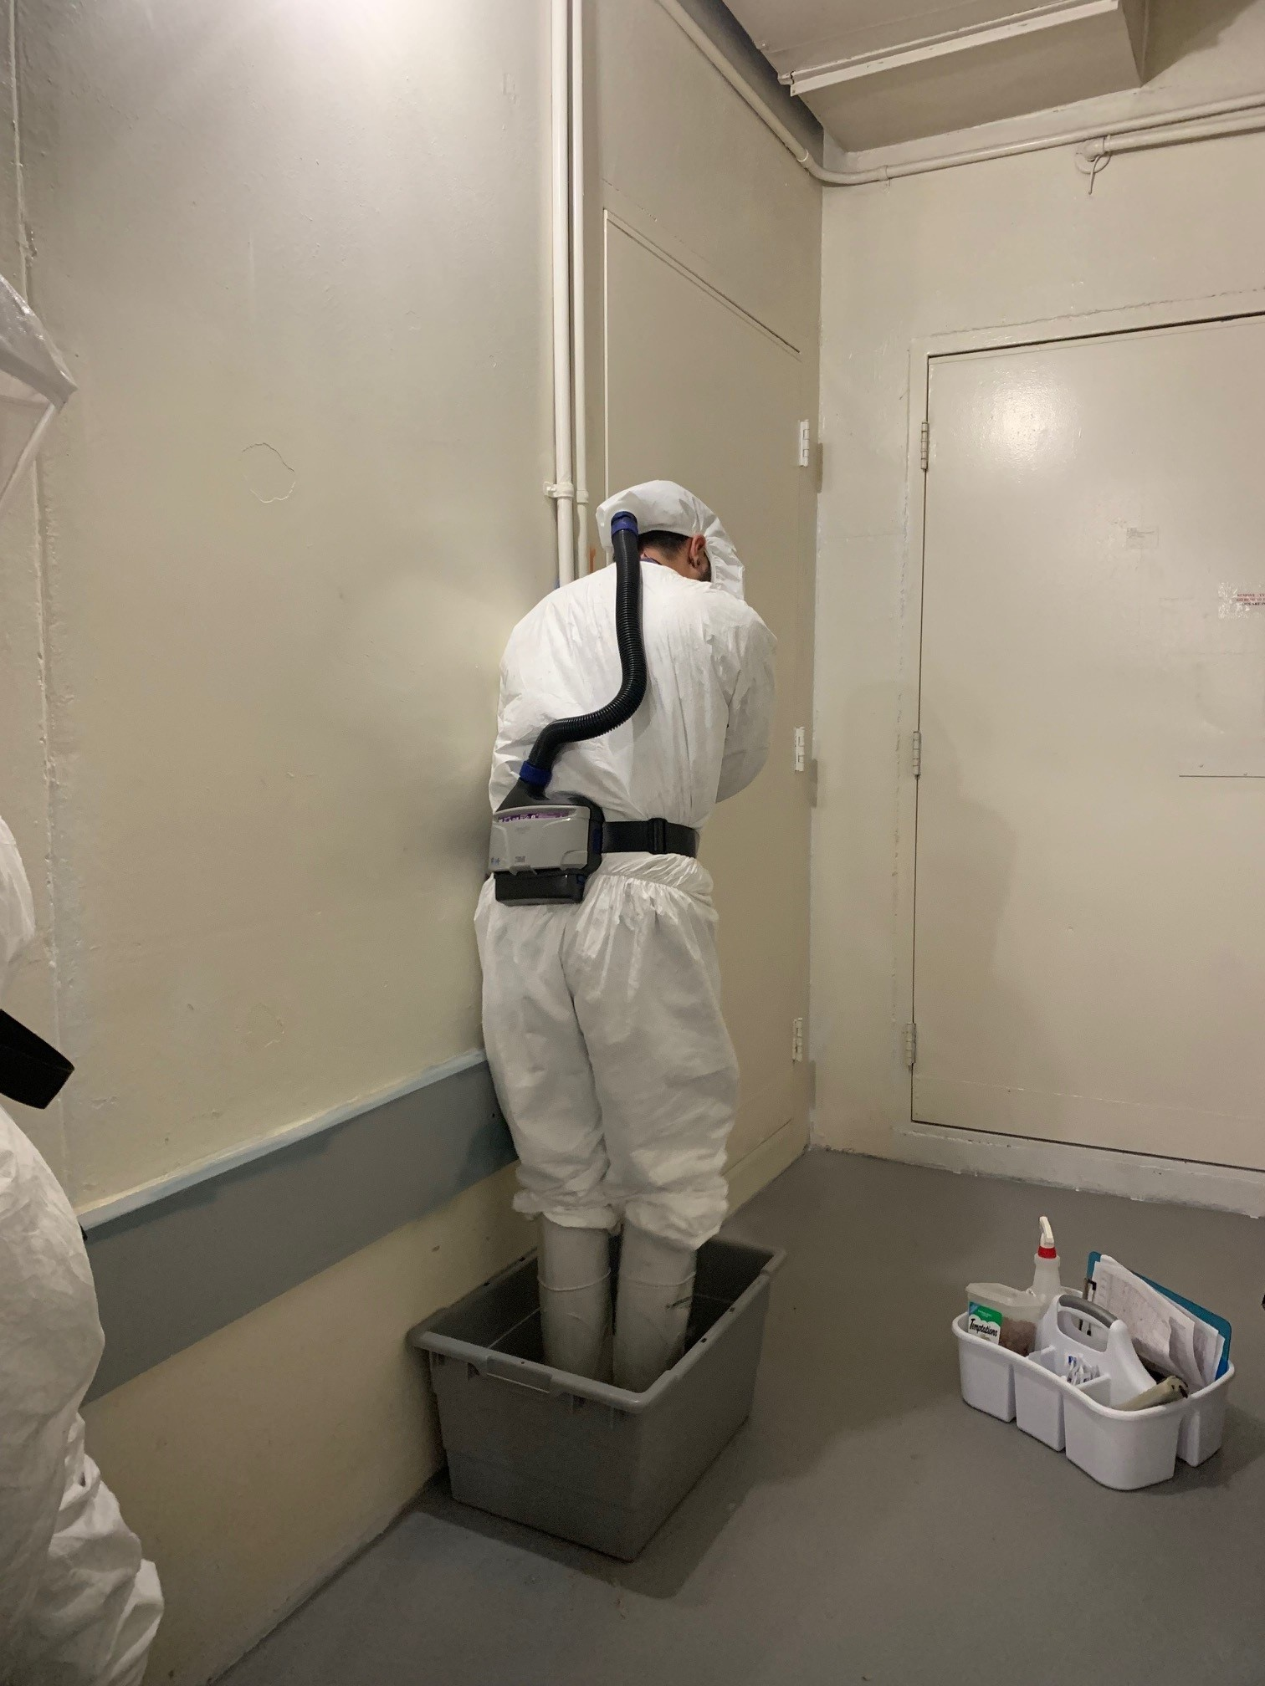
ABSL-3 PPE

Slide 12
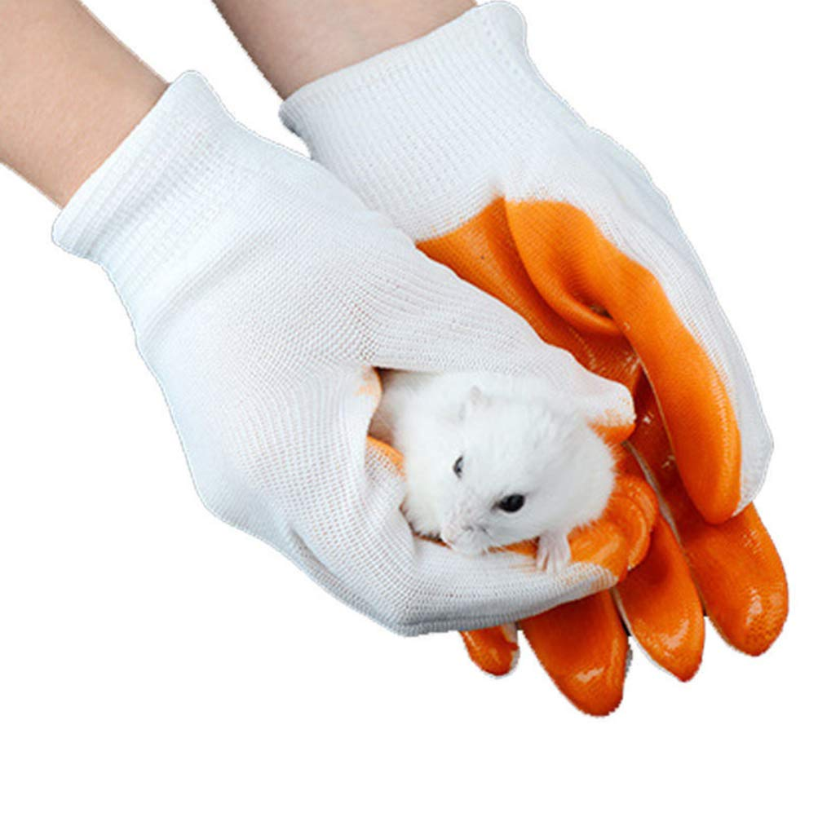
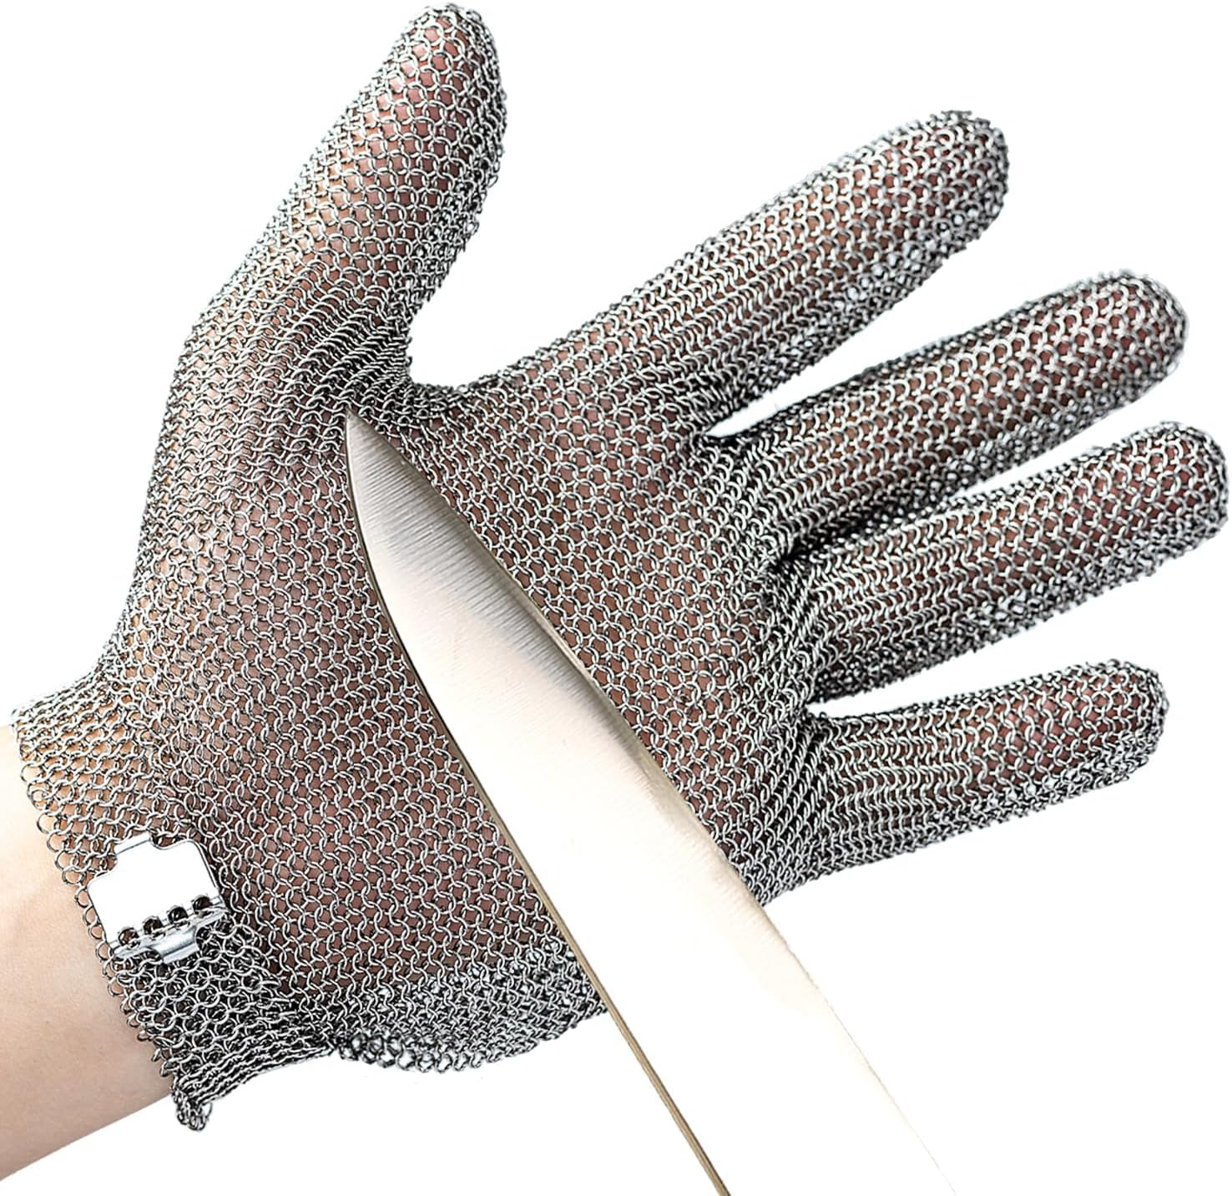
Specialized PPE

Slide 13
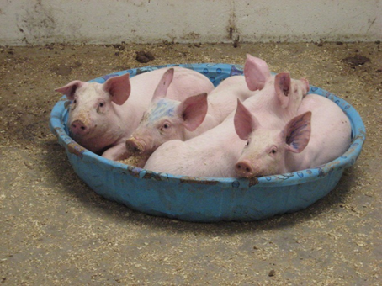
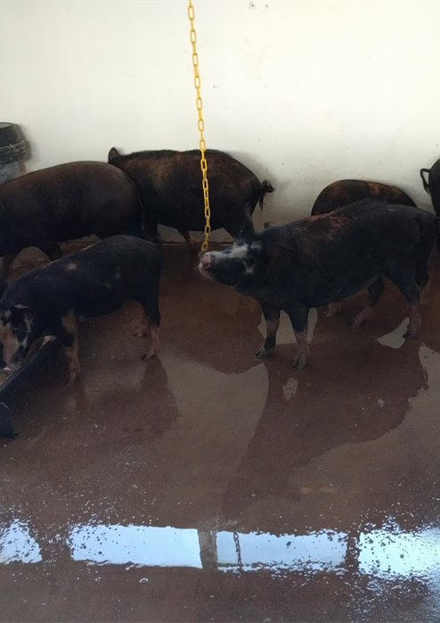
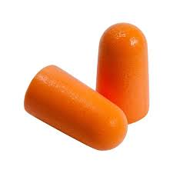
Specialized PPE

Slide 14
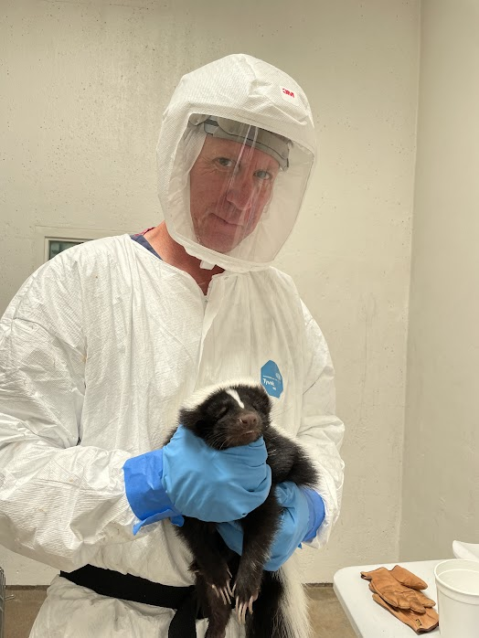
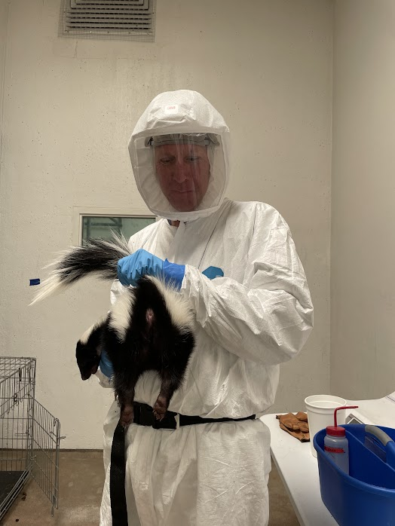
Specialized PPE??

Slide 15
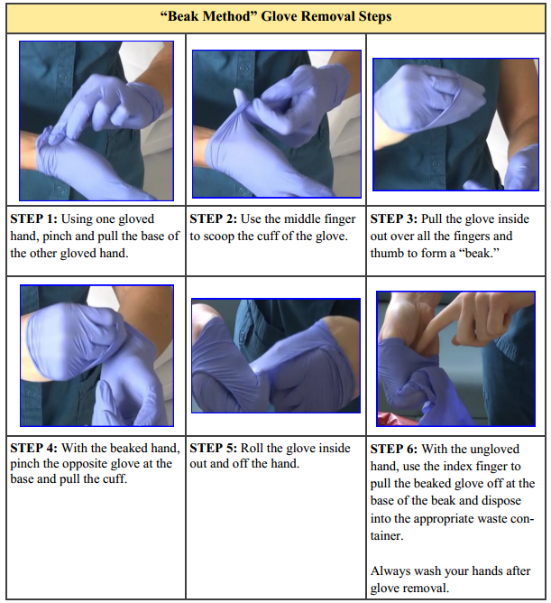
Doffing PPE

Slide 16
Conclusions
PPE changes when tasks/conditions change
Don’t rely on PPE alone
References:
Biological Safety Principles and Practices, 5th Edition
Biosafety in Microbiological and Biomedical Laboratories, 6th Edition

